Slide 1
Searching and Sorting
Linear Search
Binary Search
-Reading p.671-679
© 2006 Pearson Addison-Wesley. All rights reserved

Slide 2
Linear Search
Searching is the process of determining whether or not a given value exists in a data structure or a storage media.
We discuss two searching methods on one-dimensional arrays: linear search and binary search.
The linear (or sequential) search algorithm on an array is:
  Sequentially scan the array, comparing each array item with the searched value.
  If a match is found; return the index of the matched element; otherwise return –1.
Note: linear search can be applied to both sorted and unsorted arrays.
© 2006 Pearson Addison-Wesley. All rights reserved

Slide 3
Linear Search
The algorithm translates to the following Java method:
  public static int linearSearch(Object[] array, Object key)
  {
  for(int k = 0; k < array.length; k++)
  if(array[k].equals(key))
  return k;
  return -1;
  }
© 2006 Pearson Addison-Wesley. All rights reserved

Slide 4
Binary Search
Binary search uses a recursive method to search an array to find a specified value
The array must be a sorted array:
  a[0]≤a[1]≤a[2]≤. . . ≤ a[finalIndex]
If the value is found, its index is returned
If the value is not found, -1 is returned
Note: Each execution of the recursive method reduces the search space by about a half
© 2006 Pearson Addison-Wesley. All rights reserved

Slide 5
Binary Search
An algorithm to solve this task looks at the middle of the array or array segment first
If the value looked for is smaller than the value in the middle of the array
  Then the second half of the array or array segment can be ignored
  This strategy is then applied to the first half of the array or array segment
© 2006 Pearson Addison-Wesley. All rights reserved

Slide 6
Binary Search
If the value looked for is larger than the value in the middle of the array or array segment
  Then the first half of the array or array segment can be ignored
  This strategy is then applied to the second half of the array or array segment
If the value looked for is at the middle of the array or array segment, then it has been found
If the entire array (or array segment) has been searched in this way without finding the value, then it is not in the array
© 2006 Pearson Addison-Wesley. All rights reserved

Slide 7
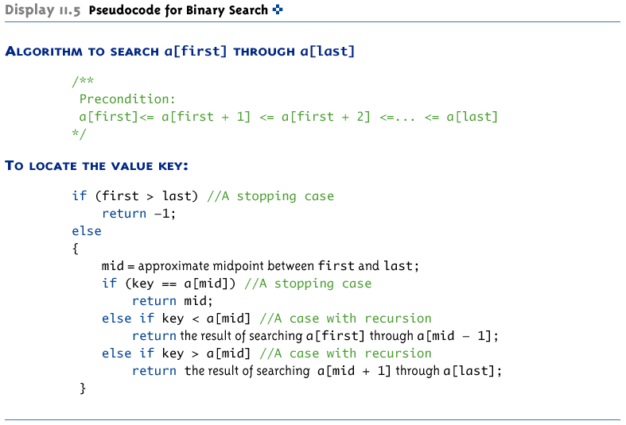
Pseudocode for Binary Search
© 2006 Pearson Addison-Wesley. All rights reserved

Slide 8
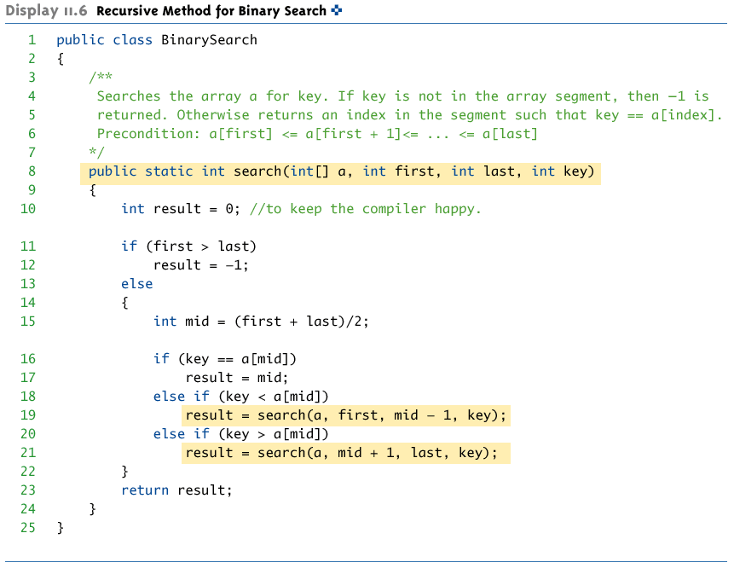
Recursive Method for Binary Search
© 2006 Pearson Addison-Wesley. All rights reserved

Slide 9
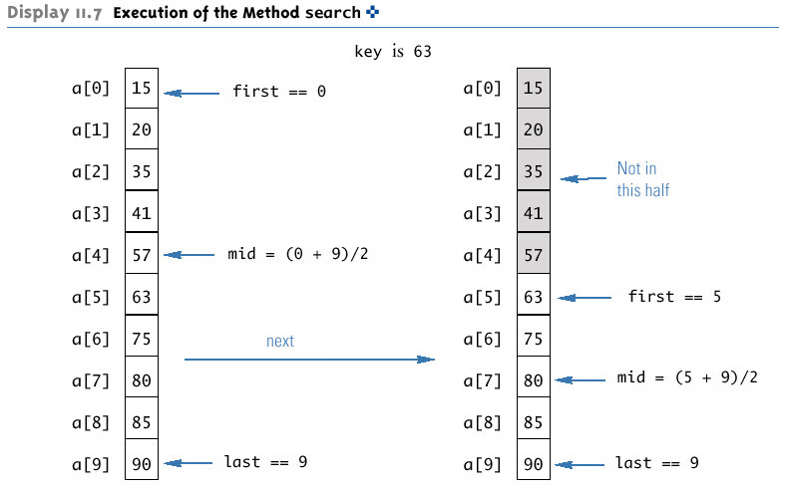
Execution of the Method search
(Part 1 of 2)
© 2006 Pearson Addison-Wesley. All rights reserved

Slide 10
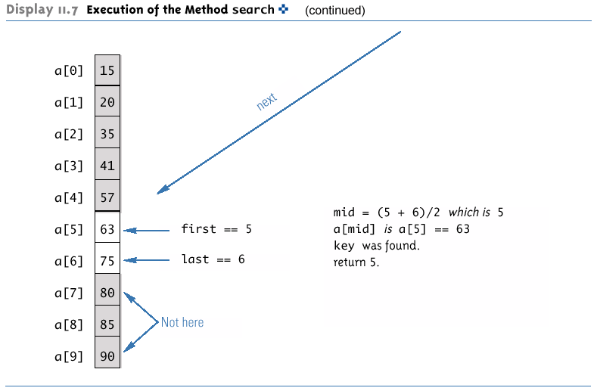
Execution of the Method search
(Part 1 of 2)
© 2006 Pearson Addison-Wesley. All rights reserved

Slide 11
Checking the search Method
There is no infinite recursion
  On each recursive call, the value of first is increased, or the value of last is decreased
  If the chain of recursive calls does not end in some other way, then eventually the method will be called with first larger than last
© 2006 Pearson Addison-Wesley. All rights reserved

Slide 12
Checking the search Method
Each stopping case performs the correct action for that case
  If first > last, there are no array elements between a[first] and a[last], so key is not in this segment of the array, and result is correctly set to -1
  If key == a[mid], result is correctly set to mid
© 2006 Pearson Addison-Wesley. All rights reserved

Slide 13
Checking the search Method
For each of the cases that involve recursion, if all recursive calls perform their actions correctly, then the entire case performs correctly
  If key < a[mid], then key must be one of the elements a[first] through a[mid-1], or it is not in the array
  The method should then search only those elements, which it does
  The recursive call is correct, therefore the entire action is correct
© 2006 Pearson Addison-Wesley. All rights reserved

Slide 14
Checking the search Method
  If key > a[mid], then key must be one of the elements a[mid+1] through a[last], or it is not in the array
  The method should then search only those elements, which it does
  The recursive call is correct, therefore the entire action is correct
The method search passes all three tests:
Therefore, it is a good recursive method definition
© 2006 Pearson Addison-Wesley. All rights reserved

Slide 15
Efficiency of Binary Search
The binary search algorithm is extremely fast compared to an algorithm that tries all array elements in order
  About half the array is eliminated from consideration right at the start
  Then a quarter of the array, then an eighth of the array, and so forth
© 2006 Pearson Addison-Wesley. All rights reserved

Slide 16
Efficiency of Binary Search
Given an array with 1,000 elements, the binary search will only need to compare about 10 array elements to the key value, as compared to an average of 500 for a serial search algorithm
The binary search algorithm has a worst-case running time that is logarithmic: O(log n)
  A serial search algorithm is linear: O(n)
If desired, the recursive version of the method search can be converted to an iterative version that will run more efficiently
© 2006 Pearson Addison-Wesley. All rights reserved

Slide 17
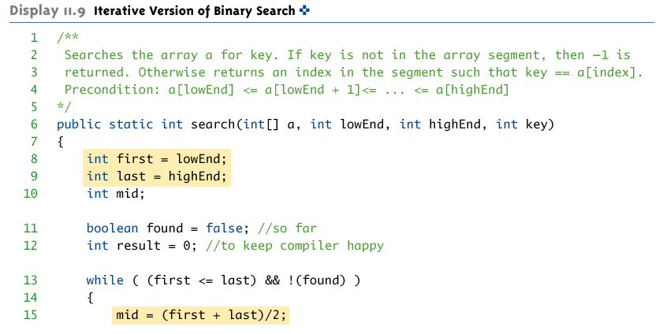
Iterative Version of Binary Search
(Part 1 of 2)
© 2006 Pearson Addison-Wesley. All rights reserved

Slide 18
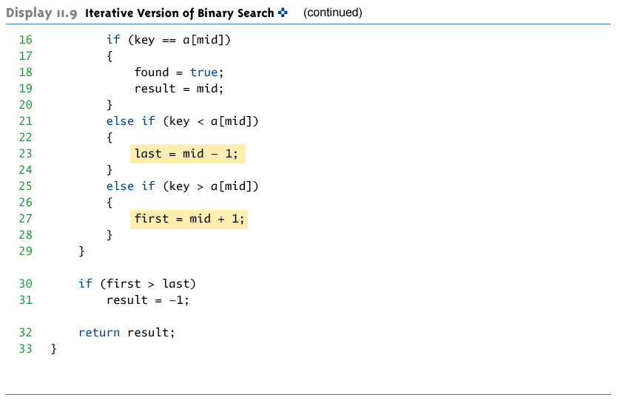
Iterative Version of Binary Search
(Part 2 of 2)
© 2006 Pearson Addison-Wesley. All rights reserved

